Slide 1

WIPRO NGA Program – SDET – Batch No:1
Capstone Project Presentation – 9th Sept 2024
Project Title Here – Gillette Indian Homepage
Presented by – Mareswari Gunji
www.rpsconsulting.in

Slide 2
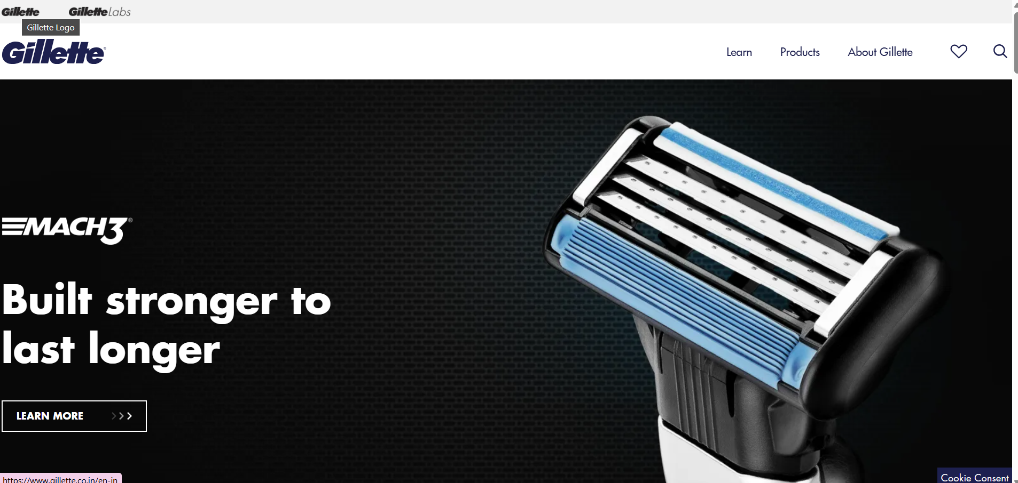

Introduction
Overview of Gillette Indian Homepage Website:
The Testing process ensures that Gillette Indian Homepage provides a seamless , reliable, and secure shopping experience to millions of users.
The presentation outlines the testing ,tools used and results obtained.
2024 - RPS Consulting all rights reserved

Slide 3
Objective
Primary Goal:
To ensure that all functionalities of the Gillette Indian Homepage website are working efficiently, bug-free, and provide a seamless user experience..
Key Objectives:
Test Environment Setup
Profile Management
Content Posting
Search Functionality
Response & Design Testng
Cross Browser Testing
Extent Report
Specific Objectives:
Manage task and track processing using Jira.
Perform API testing to validate backend services.
Implement automatic test using Selenium and cucumber.
Maintain high quality standards through continuous testing.
2024 - RPS Consulting all rights reserved

Slide 4




About the Application
Application : Gillette Indian Homepage
Description : Online retail, offering a wide range of products and services.
Key functionalities :
Include product search, user accounts, shopping cart, checkout, and payment gateways.
Requires robust testing due to the high volume of users and transactions.
Tech Stack: Selenium , WebDriver , Cucumber , Rest Assured, Postman
2024 - RPS Consulting all rights reserved

Slide 5
Task Completed:
Manual Testing:
Test case creation and execution.
Exploratory testing to identify potential issues.
Jira:
Issue tracking and management.
Creating and managing test cycles.
Selenium BDD with Cucumber:
Automated UI testing using Selenium WebDriver.
Writing and executing BDD scenarios using Cucumber.
API Testing:
Testing RESTful APIs using Rest Assured.
Validating API responses and ensuring data integrity.
2024 - RPS Consulting all rights reserved

Slide 6
Manual Testing
Manual Testing is the process of manually executing test cases without using any automation tools. In this approach, a tester plays the role of an end user and verifies that all features of the application are working as expected. The main goal of manual testing is to identify bugs, issues, or defects in the software by interacting with the application as a real user would.
Key Aspects of Manual Testing
Human Intervention : All actions are performed by a tester, such as navigating through the application, entering data, and verifying outputs.
Test Case Execution : Testers follow predefined test cases or create new ones based on the application’s functionality.
Exploratory Testing : Testers can explore the application without predefined scripts to discover edge cases or unexpected issues.
Verification of Functionality : It checks whether the application behaves according to the specified requirements.
Defect Identification : Manual testing helps in finding issues that automation might miss, especially those related to usability and user experience.
Advantages :
Flexibility : Can test UI/UX elements and adapt to complex scenarios that automation may not handle well.
No Coding Required : Doesn't require knowledge of programming languages.
Flexibility Human In sight : Human intuition can spot usability issues and unexpected errors better than automated tests.
Disadvantages:Time Consuming : Requires more time and effort compared to automated testing.
Less Accuracy : Human error is possible during test execution.
2024 - RPS Consulting all rights reserved

Slide 7
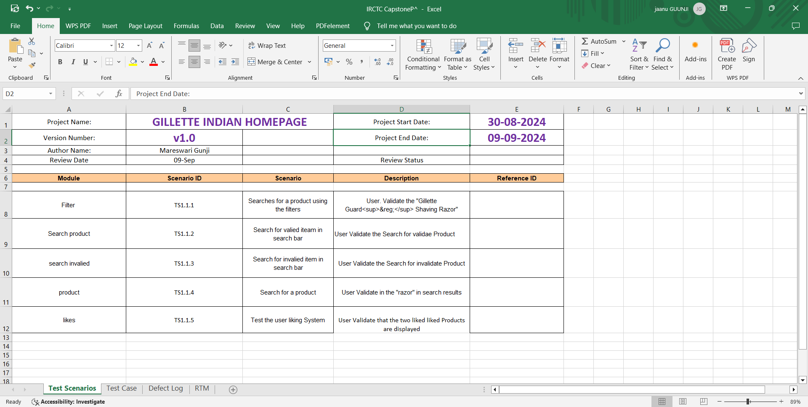
Manual Testing Output-1
2024 - RPS Consulting all rights reserved

Slide 8
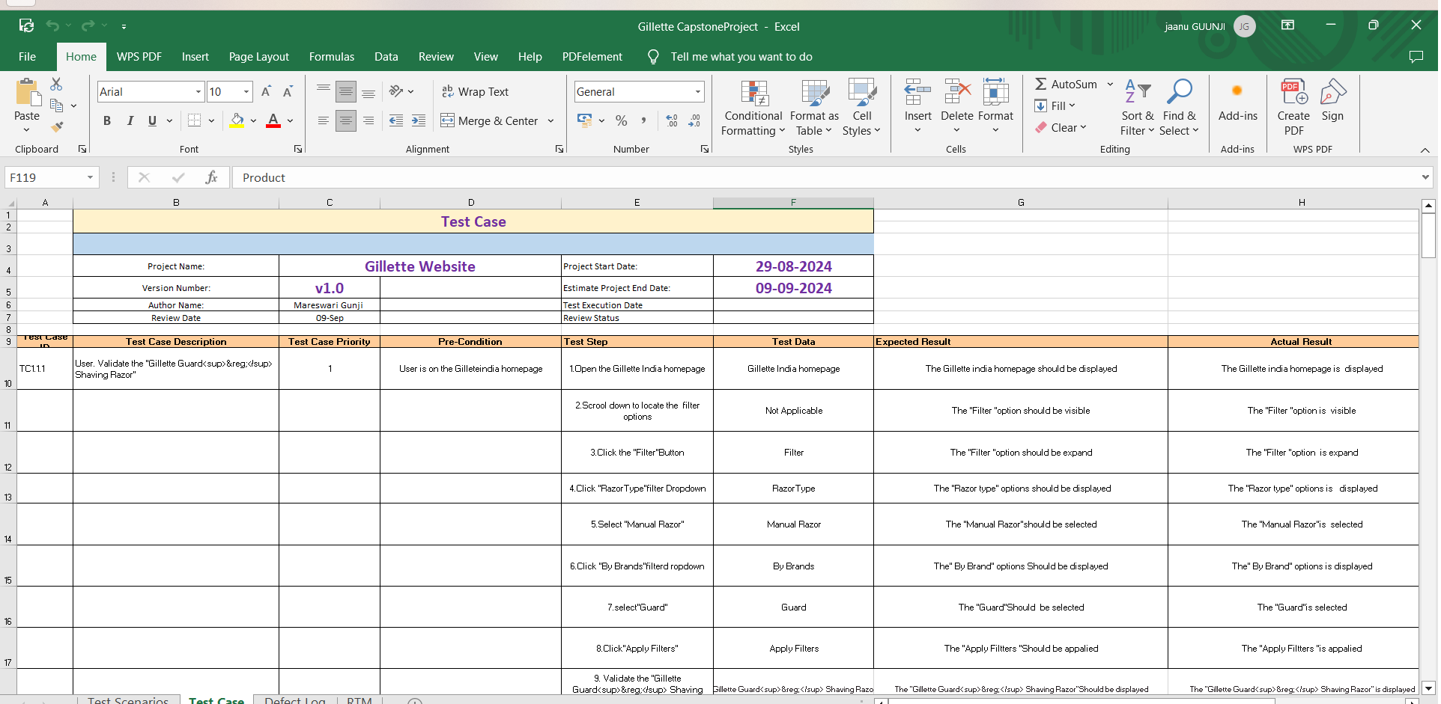
Manual Testing Output-2
2024 - RPS Consulting all rights reserved

Slide 9
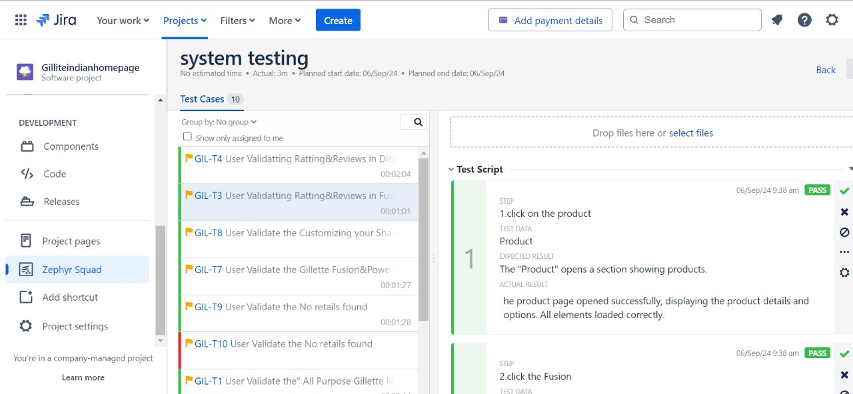
Jira
Jira is a popular project management and issue-tracking tool developed by Atlassian. It is primarily used by software development teams to plan, track, and manage tasks, bugs, and project progress throughout the development lifecycle. Jira helps teams collaborate more efficiently by providing a centralized platform to report, assign, and prioritize work.
2024 - RPS Consulting all rights reserved

Slide 10
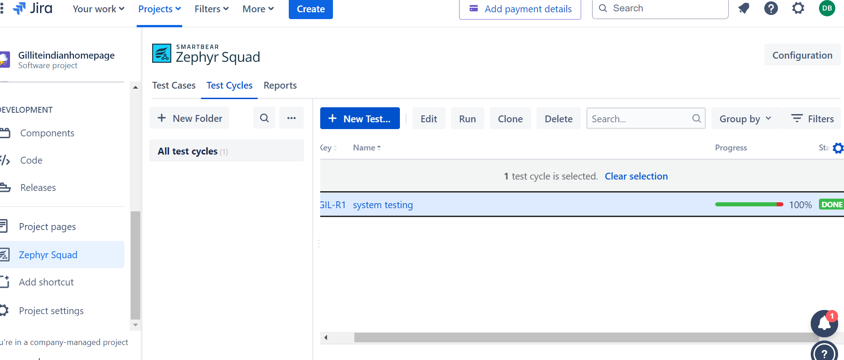
Jira Output Example-2
2024 - RPS Consulting all rights reserved

Slide 11
Selenium BDD with Cucumber
Selenium:
Selenium is an open-source framework used for automating web browsers.
It allows testers to simulate user actions like clicking buttons, entering text, and navigating web pages.
Selenium supports multiple programming languages such as Java, Python, and C#, and it works across various browsers like Chrome, Firefox, and Edge.
Cucumber:
Cucumber is a BDD framework that allows tests to be written in Gherkin language, which is a plain English format.
It bridges the gap between non-technical stakeholders and developers/testers by writing test scenarios in a format everyone can understand.
Benefits of Using Selenium BDD with Cucumber:
Cucumber Readable Tests: Test scenarios are written in plain English, making them easy to understand for both technical and non-technical team members.
Collaboration: Encourages collaboration between testers, developers, and business stakeholders.
Automation: Selenium automates browser actions, reducing manual testing effort.
Reusability: Gherkin scenarios can be reused across multiple tests.
Detailed Reports :Cucumber generates detailed reports for better tracking of test results.
2024 - RPS Consulting all rights reserved

Slide 12
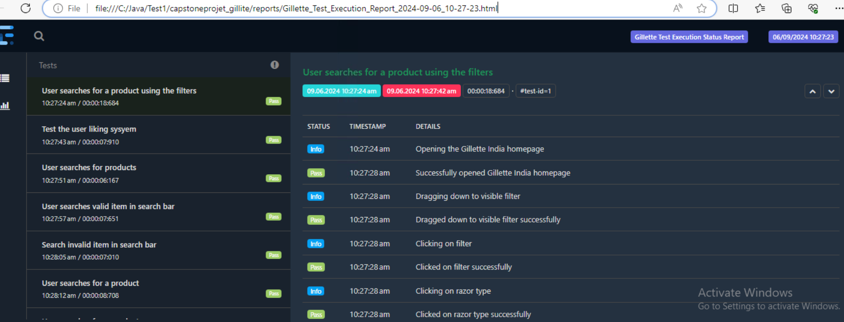
Selenium BDD with Cucumber Extended Report
2024 - RPS Consulting all rights reserved

Slide 13
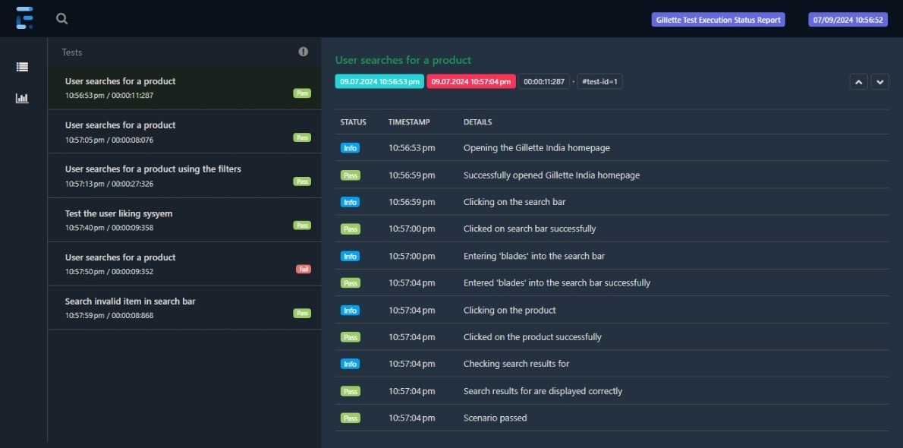
Selenium BDD with Cucumber Extended Report
2024 - RPS Consulting all rights reserved

Slide 14
API Testing
API Testing is a type of software testing that focuses on verifying and validating the functionality, reliability, performance, and security of Application Programming Interfaces (APIs). APIs allow different software applications to communicate and exchange data, and API testing ensures that these interactions work as expected.
Key Concepts of API Testing:
An API allows two different systems or applications to communicate. For example, when you use a mobile app to book a flight, the app communicates with an airline’s API to get flight details.
API testing is essential to ensure that the data exchange between systems is accurate and secure.
Types of API Testing :
Functional Testing :Verifying that the API works according to the specified functionality .
Performance Testing : Ensuring the API responds quickly and handles high loads efficiently.
Security Testing : Checking if the API is protected against unauthorized access and potential vulnerabilities.
Validation Testing : Ensuring that the API follows best practices and returns the correct response formats.
Load Testing : Testing the API’s behavior under heavy traffic or user requests.
Tools : Postman , Rest Assured.
Requests:
GET :Retrieve posts.
POST :Create a new model.
PUT :Update a Post.
Delete :Remove a Post.
2024 - RPS Consulting all rights reserved

Slide 15
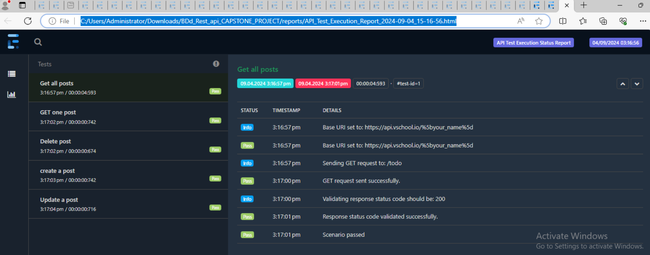
BDD Rest Assured Extended Report
2024 - RPS Consulting all rights reserved

Slide 16
Approach
Test Strategy:
Identified critical functionalities for manual and automated testing.
Automation Approach:
Designed BDD test cases with Cucumber for features like search, filter, and checkout.
Integrated automated tests into CI/CD for frequent execution.
Manual Testing Approach:
Conducted exploratory testing to cover edge cases and unexpected user behaviors.
Performed compatibility testing on different browsers and devices.
2024 - RPS Consulting all rights reserved

Slide 17
Defects Found
Summary of Defects :
Identified UI issues such as button alignment, broken links, and inconsistent styling.
Found functional issues in checkout, cart synchronization, and API response delays.
Defect Examples :
Incorrect product filters returning invalid results.
API returning incomplete or delayed responses for product search.
2024 - RPS Consulting all rights reserved

Slide 18
Challenges and Overcome
Challenges :
Testing a complex, high-traffic website with frequent updates and deployments.
Managing test environments that accurately simulate real-world user conditions.
Handling asynchronous processes and dynamic data in test automation.
Solutions:
Adopted parallel testing to reduce time.
Improved test data management to ensure consistency across environments.
Collaborated with development teams to resolve API issues quickly.
2024 - RPS Consulting all rights reserved

Slide 19
Conclusion
Summary:
Successfully automated and manually tested critical areas of the Gillette Indian Homepage website , search,likeproducts,filter. Found and resolved key defects that enhanced the overall user experience .
Improved the efficiency of the testing process using Jira, Selenium, and API testing tools.
2024 - RPS Consulting all rights reserved

Slide 20


Slide 21


